Slide 1
Computer Vision
Fall 2017 16720
Instructor: S. Narasimhan, D. Held
DH 2315
M-W 4:30pm – 5:50pm

Slide 2
Image Alignment and Tracking Homography Estimation Lucas Kanade

Slide 3
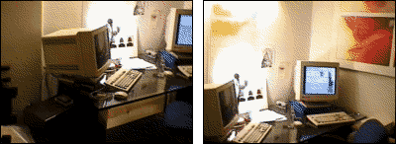
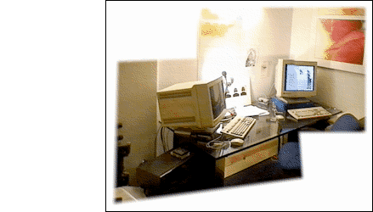
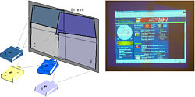
Image Alignment
Goal: Estimate single (u,v) translation (transformation) for entire image
Notes:
There’s a subproblem of motion estimation is very useful and that is image alignment. In this case, the entire image has the same translation value so the optical flow values for every pixel is the same. So in some sense, the window is the entire image!
So we can compute it very well with the pyramid-based lucas-kanade method.

Slide 4
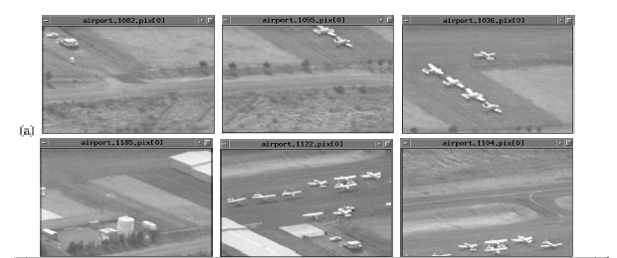
Mosaicing
(Michal Irani, Weizmann)

Slide 5
Mosaicing
(Michal Irani, Weizmann)

Slide 6
Applications of Image Alignment
Ubiquitous computer vision technique
Mosaicing
Tracking
Parametric and layered motion estimation
Image registration and alignment
Face coding / parameterization
Super-resolution

Slide 7
Recall - Image Processing Lecture
Some operations preserve the range but change the domain of f :
What kinds of operations can this perform?

Slide 8
Homography

Slide 9
Motion of a Plane
P
P’
(u,v)
Notes:
Assumption III: The scene is planar. In that case, we know (see hw1) that the mapping from one image to the other is a homography H. That is, if the coordinates in one image are (x,y), the coordinates in the next image are (x’,y’) with:
This is the case whether we consider a fixed scene from a moving camera or a rigidly moving scene from a fixed camera.
Therefore the motion is given by:
H can be estimated directly by using the general conservation equation. For small motions, the term in u in this expression can be rewritten as:
Assuming the denominator approximately constant over the window used for the computation,, we get an expression of u as:
Note that, although this expression in quadratic in the known quantities x and y, it is linear in the unknown parameters h_{ij}. By symmetry, the same applies to v, and we end up with linear expressions of the motion as function of the unknowns:
Therefore, the motion parameters can be estimated using linear least-squares as before by minimizing:
With respect to the 8 unknown parameters.

Slide 10
p’
P
p
Notes:
We get the same relation (homography from one image to the other) whether we consider a fixed scene from a moving camera or a rigidly moving scene from a fixed camera.

Slide 11
Planar Scene Motion
Camera Rotation
P
P
P’
p’
p
O
Notes:
Homographies:
This motion model covers the case of planar motion, but it also covers another important case: the case in which the motion is a pure rotation about the optical axis of the camera. Suppose that a camera is rotating about its optical center, the projection of a point of coordinates [X Y Z] at some time can be assumed to be given by:
After rotation by R around the optical center, the coordinates are:
Note that the fourth column of the rotation matrix is 0 because there is no translation between the two views. We can eliminate X,Y,Z between the two equations to yield:
This implies that the motion between the two images is described by a homography. Geometrically, the reason is that the way a point moves in the image is independent of the depth of the point. This property can be exploited to build mosaics from rotating cameras, for example.

Slide 12
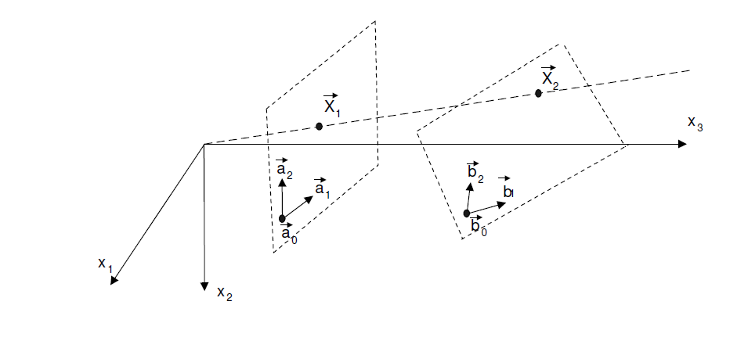
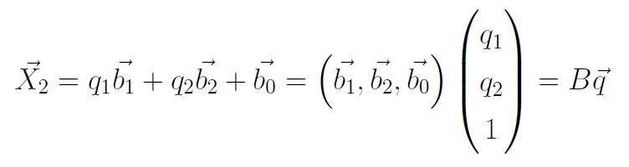
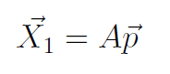
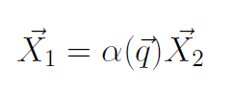
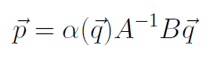
Planar Homography
Perspective :
Homography:
Notes:
Homographies:
This motion model covers the case of planar motion, but it also covers another important case: the case in which the motion is a pure rotation about the optical axis of the camera. Suppose that a camera is rotating about its optical center, the projection of a point of coordinates [X Y Z] at some time can be assumed to be given by:
After rotation by R around the optical center, the coordinates are:
Note that the fourth column of the rotation matrix is 0 because there is no translation between the two views. We can eliminate X,Y,Z between the two equations to yield:
This implies that the motion between the two images is described by a homography. Geometrically, the reason is that the way a point moves in the image is independent of the depth of the point. This property can be exploited to build mosaics from rotating cameras, for example.

Slide 13
Planar Homography: Important Points
If camera rotates about its center, then the images are related by a Homography irrespective of scene depth.
If the scene is planar, then images from cameras at any two positions and orientations are related by a Homography.
Homography mapping is a 3x3 matrix with 8 degrees of freedom.
Notes:
Homographies:
This motion model covers the case of planar motion, but it also covers another important case: the case in which the motion is a pure rotation about the optical axis of the camera. Suppose that a camera is rotating about its optical center, the projection of a point of coordinates [X Y Z] at some time can be assumed to be given by:
After rotation by R around the optical center, the coordinates are:
Note that the fourth column of the rotation matrix is 0 because there is no translation between the two views. We can eliminate X,Y,Z between the two equations to yield:
This implies that the motion between the two images is described by a homography. Geometrically, the reason is that the way a point moves in the image is independent of the depth of the point. This property can be exploited to build mosaics from rotating cameras, for example.

Slide 14
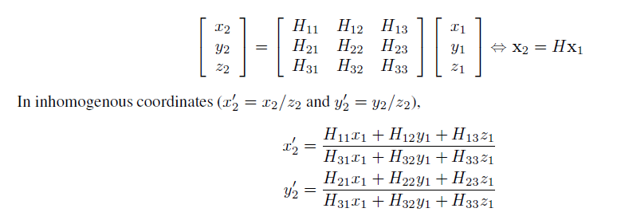
Estimating Homography
Inhomogeneous coordinates:
Notes:
Homographies:
This motion model covers the case of planar motion, but it also covers another important case: the case in which the motion is a pure rotation about the optical axis of the camera. Suppose that a camera is rotating about its optical center, the projection of a point of coordinates [X Y Z] at some time can be assumed to be given by:
After rotation by R around the optical center, the coordinates are:
Note that the fourth column of the rotation matrix is 0 because there is no translation between the two views. We can eliminate X,Y,Z between the two equations to yield:
This implies that the motion between the two images is described by a homography. Geometrically, the reason is that the way a point moves in the image is independent of the depth of the point. This property can be exploited to build mosaics from rotating cameras, for example.

Slide 15
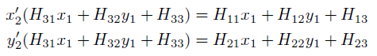
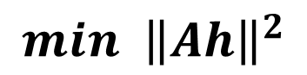
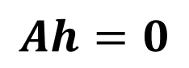
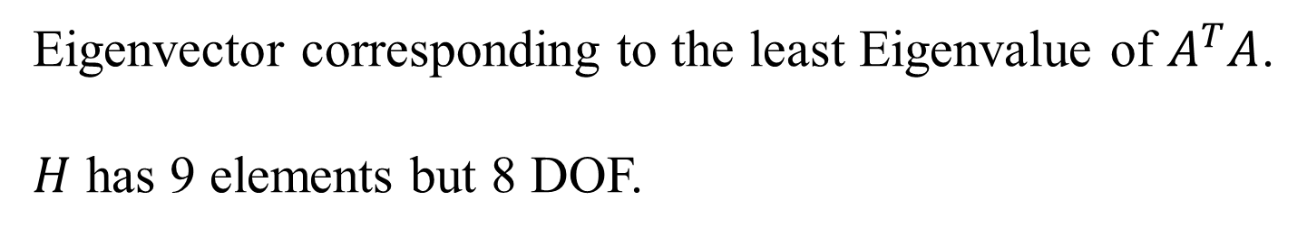
Estimating Homography
Linearize:
Choose at least 4 points and solve homogeneous
least squares:
$$Ah=0$$
$$min {\left\|Ah\right\|}^{2}$$
Eigenvector corresponding to the least Eigenvalue of $A^{T}A$.
$H$ has 9 elements but 8 DOF.
Notes:
Homographies:
This motion model covers the case of planar motion, but it also covers another important case: the case in which the motion is a pure rotation about the optical axis of the camera. Suppose that a camera is rotating about its optical center, the projection of a point of coordinates [X Y Z] at some time can be assumed to be given by:
After rotation by R around the optical center, the coordinates are:
Note that the fourth column of the rotation matrix is 0 because there is no translation between the two views. We can eliminate X,Y,Z between the two equations to yield:
This implies that the motion between the two images is described by a homography. Geometrically, the reason is that the way a point moves in the image is independent of the depth of the point. This property can be exploited to build mosaics from rotating cameras, for example.

Slide 16
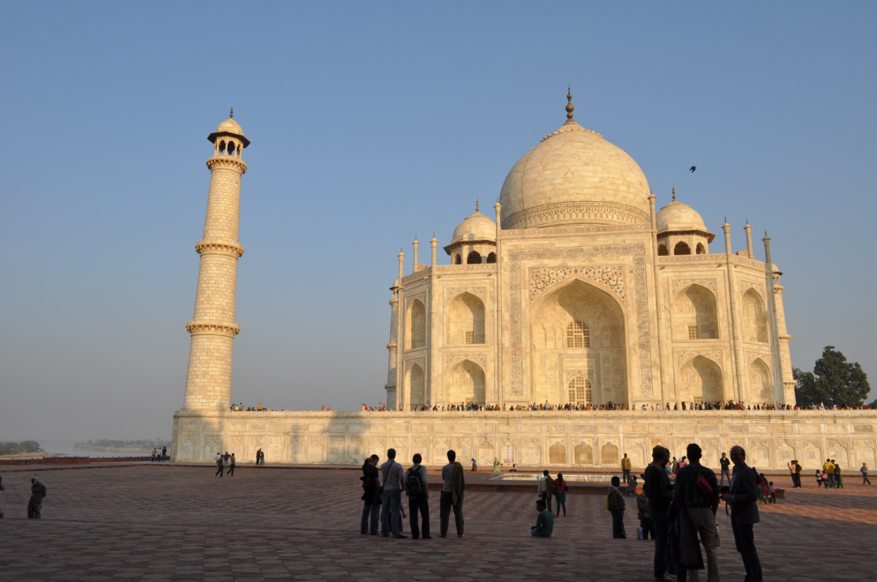
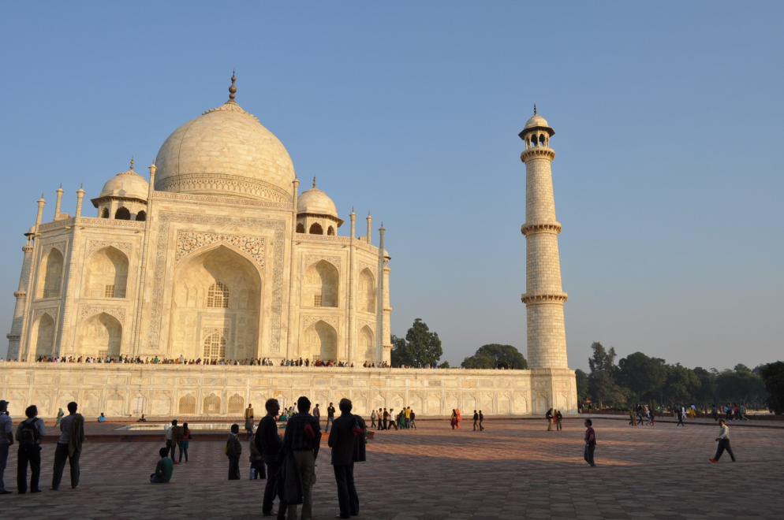
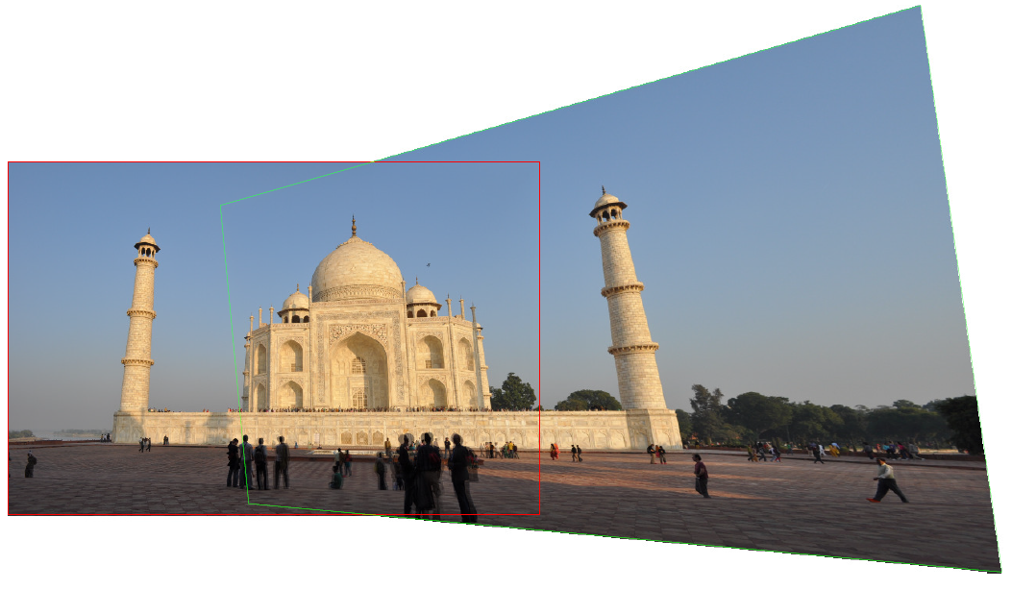

Slide 17
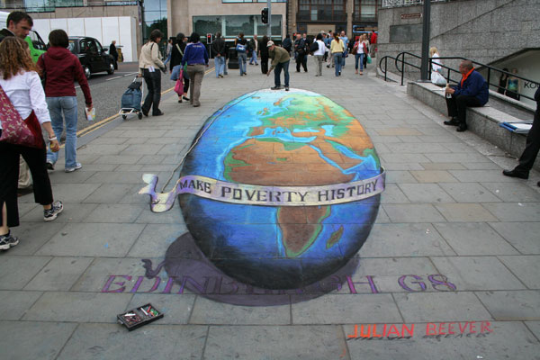
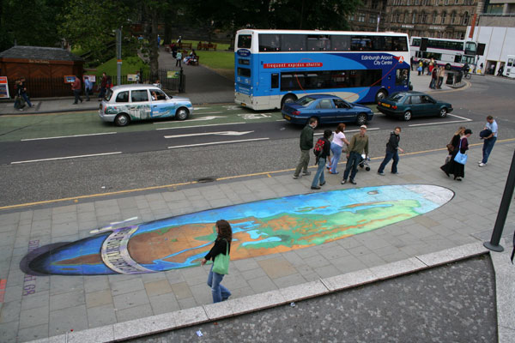
Illusions
(Julian Beever)

Slide 18
Lucas Kanade Image Alignment and Tracking
Thanks to Iain Matthews for Slides

Slide 19
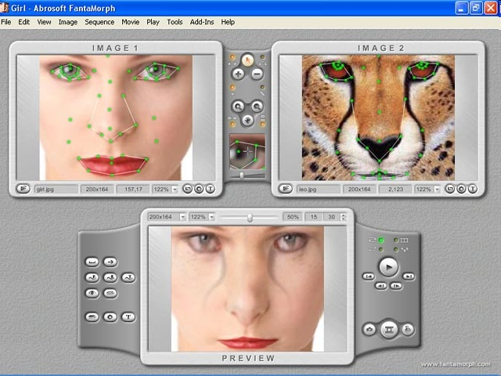
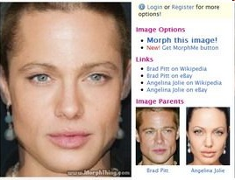
Face Morphing
Notes:
19

Slide 20
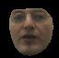
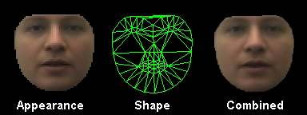
Generative Model for an Image
Parameterized model
shape
Parameters
Image
appearance
Notes:
Linear model so can project for shape and appearance from combined space.
Movie is (shape free) appearance, shape, combined shape and appearance. Runs through same space as figure, just to show can project anywhere in the linear space.
Probably this is a short slide?

Slide 21
Fitting a Model to an Image
What are the best model parameters to match an image?
shape
Parameters
Image
appearance
Nonlinear optimization problem

Slide 22
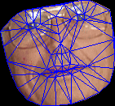
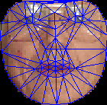
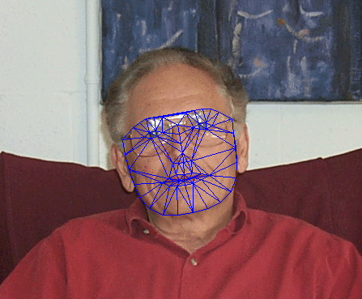

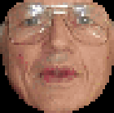
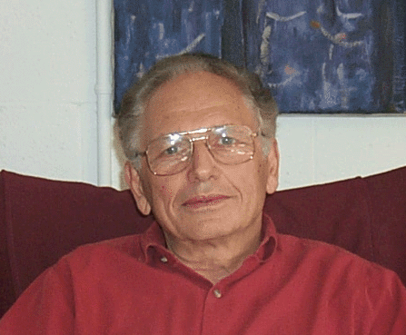
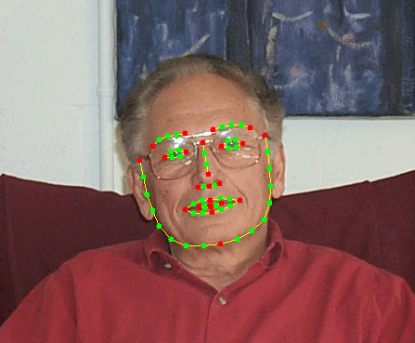
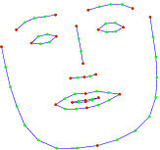
Active Appearance Model
Cootes, Edwards, Taylor, 1998
Appearance
Region of interest
Warp to reference
Landmarks
Shape
Notes:
The usual AAM figure
Example face image
Hand located landmark points on a training set of images. Use PCA to model shape variation in pose normalised (translation, rotation, scale) training set.
Use landmark points to define the region of interest. Use triangulation to do a piece-wise affine warp (texture map) to the mean shape. Sample at the mean shape and do PCA to get shape-normalised eigen-faces.
Do third PCA to project shape and appearance eigenspaces into a concatenated shape & appearance space, e.g. decorrelate shape and appearance. W is weight on shape parameters because cannot do PCA on different units (x,y position, pixel intensity). Just normalises variance.

Slide 23
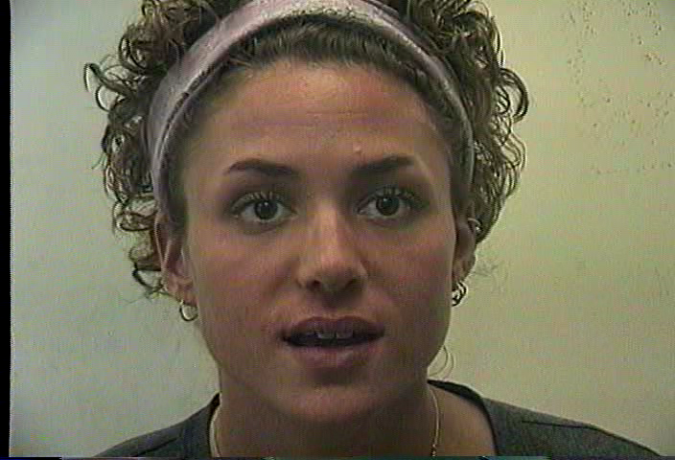
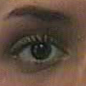
Image Alignment
Template, T(x)
Warp, W(x;p)
Image coordinates
x = (x, y)^{T}
Warp parameters,
p = (p₁, p₂, …, p_{n})^{T}
Image, I(x)

Slide 24
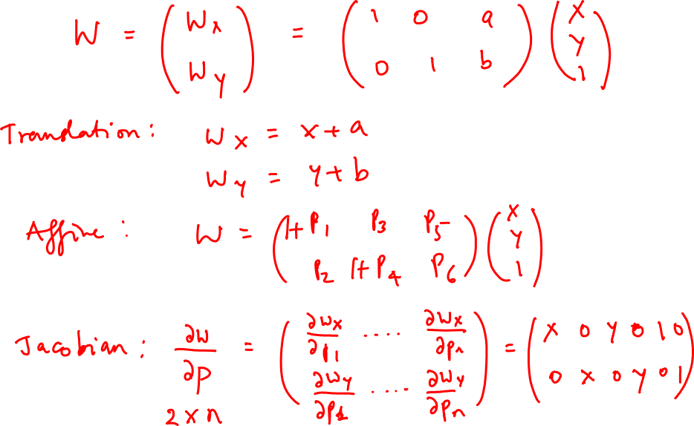
Warp and its Jacobian

Slide 25
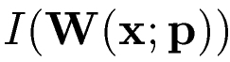
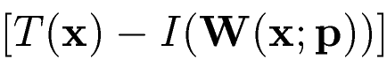
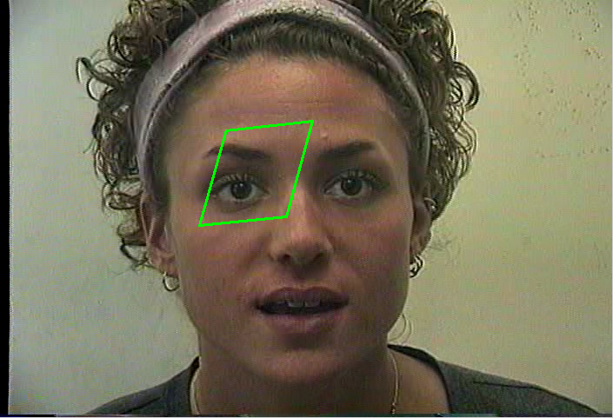
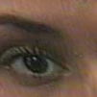
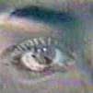
Want to: Minimize the Error
Warp image to get compute
Template, T(x)
Warped, I(W(x;p))
T(x) - I(W(x;p))

Slide 26
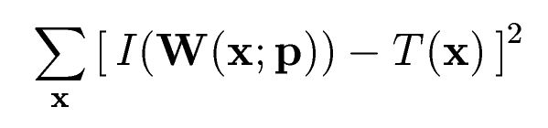
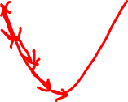
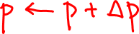
How to: Minimize the Error
Minimise SSD with respect to p,
-
=
Generally a nonlinear optimisation problem ☹
Solution: solve for increments to current estimate,

Slide 27
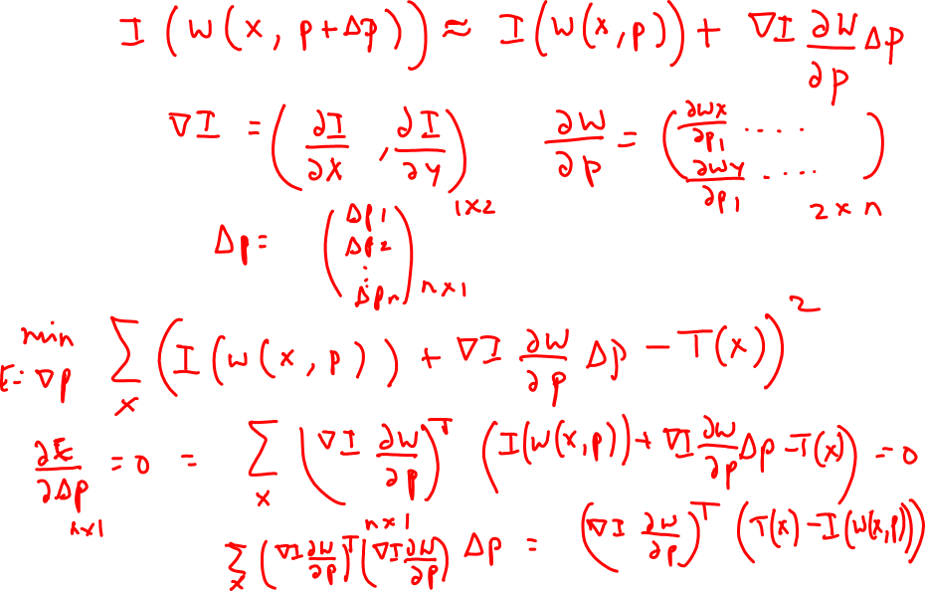
Gradient descent

Slide 28
Linearize
Taylor series expansion, linearize function f about x₀:
For image alignment:

Slide 29
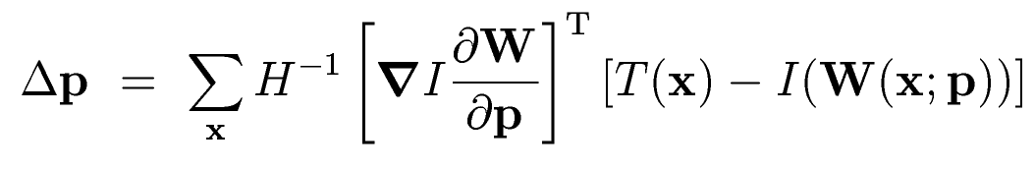
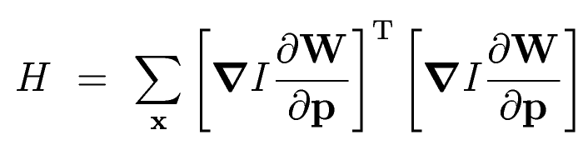
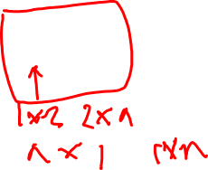
Gradient Descent Solution
Least squares problem: Minimize to solve for Δp
Error Image
Solution,
Gradient
Jacobian
Hessian

Slide 30
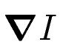
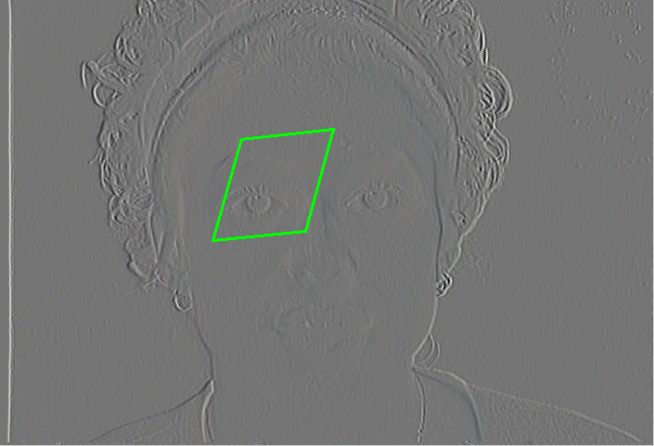
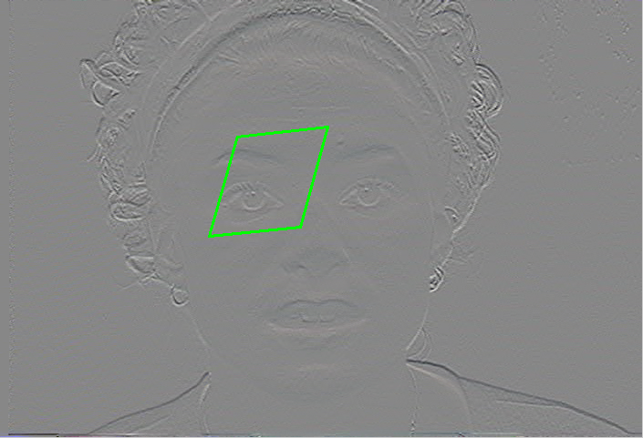
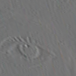
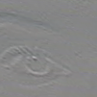
Gradient Images
Compute image gradient
W(x;p)
W(x;p)
∇I_{x}
I(W(x;p))
∇I_{y}

Slide 31




Jacobian
Compute Jacobian
Mesh parameterization
4
1
4
Warp, W(x;p)
1
Template, T(x)
Image, I(x)
3
2
3
2
Image coordinates
x = (x, y)^{T}
Warp parameters,
p = (p₁, p₂, …, p_{n})^{T} = (dx₁, dy₁, …, dx_{n}, dy_{n})^{T}
=
1
2
3
4

Slide 32
Lucas-Kanade Algorithm
Warp I with W(x;p) ⇒ I(W(x;p))
Compute error image T(x) - I(W(x;p))
Warp gradient of I to compute ∇I
Evaluate Jacobian
Compute Hessian
Compute Δp
Update parameters p ← p + Δp
-
=
⇒

Slide 33
Fast Gradient Descent?
To reduce Hessian computation:
Make Jacobian simple (or constant)
Avoid computing gradients on I

Slide 34
Shum-Szeliski Image Aligment
Additive Image Alignment – Lucas, Kanade
T(x)
W(x;p)
W(x;p+Δp)
I(x)
Compositional Alignment – Shum, Szeliski
T(x)
W(x;p) o W(x;Δp)
W(x;Δp)
W(x;p)
W(x;0 + Δp) = W(x;Δp)
I(W(x;p))
I(x)

Slide 35



Compositional Image Alignment
Minimise,
T(x)
W(x;p) o W(x;Δp)
W(x;Δp)
W(x;p)
I(W(x;p))
I(x)
Jacobian is constant, evaluated at (x, 0) ⇒ “simple”.

Slide 36
Compositional Algorithm
Warp I with W(x;p) ⇒ I(W(x;p))
Compute error image T(x) - I(W(x;p))
Warp gradient of I to compute ∇I
Evaluate Jacobian
Compute Hessian
Compute Δp
Update W(x;p) ← W(x;p) o W(x;Δp)
-
=
⇒

Slide 37

Inverse Compositional
Why compute updates on I?
Can we reverse the roles of the images?
Yes!
[Baker, Matthews CMU-RI-TR-01-03] Proof that algorithms take the same steps (to first order)

Slide 38
Forward and Inverse Compositional
Forwards compositional
T(x)
W(x;p) o W(x;Δp)
W(x;Δp)
W(x;p)
I(W(x;p))
I(x)
Inverse compositional
T(x)
W(x;p) o W(x;Δp)⁻¹
W(x;Δp)
W(x;p)
I(W(x;p))
I(x)

Slide 39





Inverse Compositional
Minimise,
Solution
Update
≈

Slide 40
Inverse Compositional
Jacobian is constant - evaluated at (x, 0)
Gradient of template is constant
Hessian is constant
Can pre-compute everything but error image!

Slide 41
Inverse Compositional Algorithm
Warp I with W(x;p) ⇒ I(W(x;p))
Compute error image T(x) - I(W(x;p))
Warp gradient of I to compute ∇I
Evaluate Jacobian
Compute Hessian
Compute Δp
Update W(x;p) ← W(x;p) o W(x;Δp)⁻¹
-
=
⇒

Slide 42
Framework
Baker and Matthews 2003
Formulated framework, proved equivalence
Algorithm | Can be applied to | Efficient? | Authors
Forwards Additive | Any | No | Lucas, Kanade
Forwards Compositional | Any semi-group | No | Shum, Szeliski
Inverse Compositional | Any group | Yes | Baker, Matthews
Inverse Additive | Simple linear 2D+ | Yes | Hager, Belhumeur

Slide 43

Example

Slide 44

Example

Slide 45

Example

Slide 46
Paper Reading
Simon Baker and Iain Matthews,
Lucas-Kanade 20 years on: A Unifying Framework, Parts 1-5

